Slide 1

Sales Performance Analysis for Better Business Decisions
Limitless Insights
Data Cleaning Specialist
Ensuring data quality and consistency
SQL Analyst
Extracting insights through structured queries
BI Developer
Building interactive dashboards
Documentation Lead
Comprehensive project documentation
Turning Raw Data into Actionable Insights

Slide 2

Team Members and Roles
Limitless Insights
Karim Azab
Basant Saeed Ahmed
Mohamed Metwally
Eman Hamdy Abdelnaby
A full-stack data analysis team responsible for data collection and cleaning, database construction, applying advanced SQL queries, and creating interactive PowerBI dashboards to deliver actionable insights

Slide 3


Project Idea and Goal
Core Idea
Comprehensive analysis of sales data to determine current market performance and identify future growth trends
Main Goal
Provide actionable insights to help decision-makers assess market evolution, identify seasonal and regional patterns, and optimize pricing and inventory strategies
Sub-Goals
Assess overall market size and sales volume
Analyze historical growth and identify cyclical patterns
Determine regional and local sales performance

Slide 4

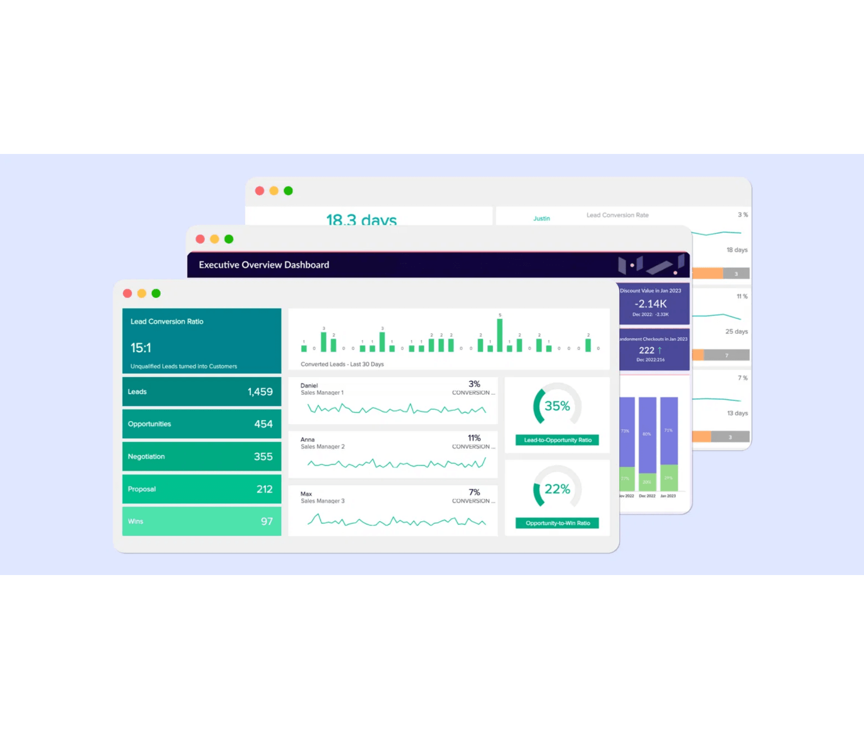
Project Methodology
Step 1
Data Preparation
Loading data from the CSV file into a MySQL database
File: Different Store.csv
Step 2
Database Construction
Creating the Sales table with required structure and all necessary columns
Key columns: invoice_no, customer_id, gender, age, category, quantity, prices, profit, payment_method, region, state, shopping_mall
Step 3
Analysis
Applying advanced SQL queries to calculate key performance indicators
Calculating margins, revenues, regional performance, and seasonality
Step 4
Visualization
Creating an interactive dashboard using PowerBI
Charts, tables, and visual performance indicators

Slide 5
Dataset Overview
Guiding the Analytics Strategy
Core KPIs Researched
Revenue
Profit & Profit Margin
Sales by Region
Sales by Category
Customer Segments
Order Priority & Payment Methods
Dataset Overview
Source
Different_stores_data_V2
Superstore-equivalent retail dataset
Data Scope
Multi-dimensional
Transactions across regions, states, and shopping malls

Slide 6
Data Cleaning and Preparation Process
Ensuring Data Quality and Reliability
Raw Data Issues
Clean Data Solutions
Challenges Identified
Improvements Applied
✕
Missing or incomplete values in key fields
✓
Handled missing values with appropriate strategies
✕
Duplicate records across transactions
✓
Removed duplicate records and validated uniqueness
✕
Inconsistent category naming and formatting
✓
Standardized all category values and naming conventions
✕
Incorrect or mixed data types
✓
Converted fields to correct data types (numeric, date, text)
Tools & Technologies Used
SQL
Power Query
Data Validation
Impact
The cleaning process transformed raw, inconsistent data into a reliable, structured source ready for advanced modeling and analysis. This ensures accuracy in all downstream KPI calculations and dashboard insights.

Slide 7
Star Schema Architecture
DAX Measures
Data Model Design
Key Calculations
Fact Table
Total Sales
FactSales
SUMX(FactSales, [quantity] * [selling_price])
invoice_no quantity selling_price cost_price Keys: date, customer, product, location, payment
Total revenue from all transactions
Total Profit
Dimension Tables
[Total Sales] - [Total Cost]
DimDate
Net profit after product costs
date_key, full_date, year, month, quarter
DimCustomer
Profit Margin
customer_id, age, gender, demographics
DIVIDE([Total Profit], [Total Sales])
DimProduct
Profitability percentage of sales
product_key, category, subcategory
Average Order Value
DimLocation
DIVIDE([Total Sales], DISTINCTCOUNT(invoice_no))
location_key, region, state, shopping_mall
Why Star Schema? Simplifies complex queries, improves dashboard performance, and ensures consistency across all reports.
Average revenue per transaction

Slide 8
Core SQL Queries
Exploratory Data Analysis
SQL-Driven Analysis
Key EDA Findings
Total Sales Revenue
→
Sales Trends Over Time
SELECT SUM(selling_price_per_unit * quantity) AS total_sales_revenue FROM sales;
Clear seasonal patterns identified with peak sales during specific months, guiding marketing campaign timing.
→
Product Category Distribution
Gross Profit Margin
Uneven distribution across categories; top 3 categories account for 65% of total revenue.
SELECT ROUND((SUM(profit) / SUM(revenue)) * 100, 2) AS profit_margin_percent FROM sales;
→
Regional Revenue Comparison
Category Profitability
Significant regional variation with top-performing region generating 3x revenue of lowest-performing region.
SELECT category, SUM(profit) AS total_profit FROM sales GROUP BY category ORDER BY total_profit DESC;
→
Customer Behavior Patterns
Average transaction value varies by region and category, informing pricing and inventory strategies.
Regional Sales
SELECT region, SUM(revenue) AS total_revenue FROM sales GROUP BY region ORDER BY total_revenue DESC;
→
Profitability Analysis
Some high-volume categories have low margins, indicating need for cost optimization or pricing adjustments.

Slide 9




Dashboard Overview: Structure and KPIs
Four Main Pages for Comprehensive Analysis
Executive Summary
Regional Analysis
High-level KPIs and performance metrics at a glance for quick decision-making
Sales and profit breakdown by geographic area, state, and shopping mall
Category Analysis
Customer Analysis
Performance metrics for different product lines and categories
Demographics, purchasing behavior, and customer segmentation insights
Primary KPIs Displayed
Interactive Elements
▸
Total Sales Revenue
▸
Dynamic date range filters
▸
Total Profit
▸
Region and category slicers
▸
Gross Profit Margin (%)
▸
Drill-through capabilities
▸
Sales by Region
▸
Comparative analysis tools
▸
Sales by Category
Designed for Decision-Makers: Real-time monitoring of sales performance with actionable insights at every level

Slide 10

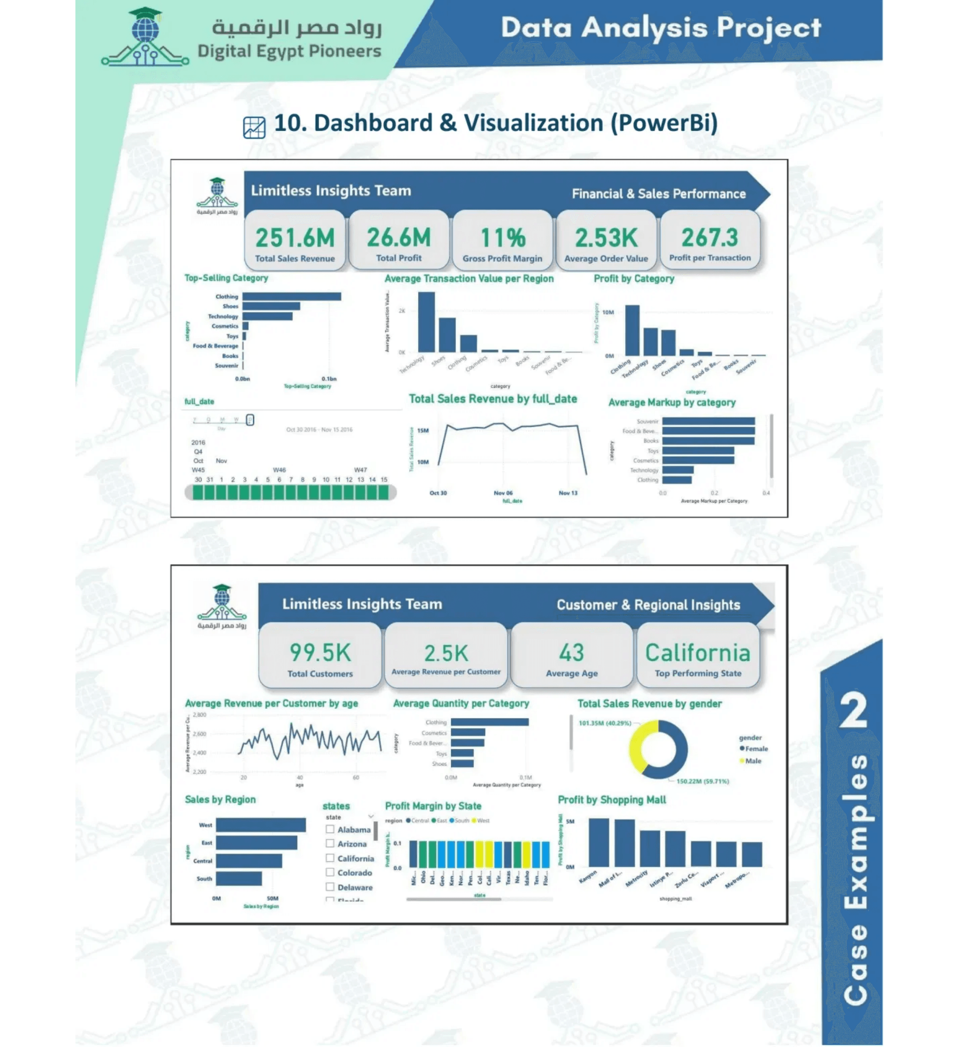
Dashboard
Transforming complex data into easily understandable visual insights through an interactive PowerBI dashboard
Key Metrics Displayed
Total Revenue
Total Profit
251.6M
26.6M
Gross Profit Margin
Avg Order Value
11%
2.53K
Dashboard Features
Top-Selling Category analysis by revenue
Average Transaction Value by region
Profit by Category breakdown
Average Markup by category
Date slicer for dynamic filtering
Sales Revenue trend over time
Added Value
Empowers users to explore data themselves and make quick, informed decisions based on visual charts and real-time indicators

Slide 11

Market Analysis and Growth Trends
Total Market Size
Calculation of the total sales value by aggregating revenue from each transaction. Data is consolidated monthly or annually to show market performance across different time periods
Historical Growth
Year-over-Year (YoY) growth analysis to understand market evolution over time. Consistent growth indicates a healthy market, while decline may signal the need for innovation
Seasonality and Cyclicality
Identifying peak sales months (e.g., holidays and seasons). These insights help in planning marketing campaigns and increasing inventory during optimal times
Strategic Value
Understanding these dimensions enables decision-makers to assess current market position and forecast future trends for improved planning and resource allocation

Slide 12

Customer & Regional Insights
PowerBI dashboard providing a comprehensive view of customer demographics and regional sales performance
Total Customers
Average Revenue per Customer
99.5K
$2.5K
Total number of unique customers in the dataset
Average spending per unique customer
Average Customer Age
Top Performing State
43
California
Mean age of customer base
Highest revenue-generating state
Key Dashboard Components
Average Revenue per Customer by Age - Shows how customer spending varies across age groups
Average Quantity per Category - Displays purchase volume by product category
Total Sales Revenue by Gender - Breakdown of revenue contribution by customer gender
Sales by Region - Revenue distribution across West, East, Central, and South regions
Strategic Value
This dashboard enables stakeholders to understand customer segmentation by demographics and geography, identify high-value regions and locations, and optimize resource allocation based on regional performance and customer behavior patterns

Slide 13



Interactive Features
Real-World Scenario
Dashboard Capabilities
Manager's Workflow
1
Filter by Region
Manager selects a specific region using the region slicer to focus analysis on that market.
Drill-Through
→ Dashboard updates instantly
Click on any high-level metric to instantly dive into detailed transactions, customer lists, or specific product data for that selection.
2
Spot Low Performance
Notices a product category with declining sales and low profit margin compared to other categories.
→ Identifies the problem
Tooltips
3
Drill-Through Analysis
Clicks on the underperforming category to see individual transactions, customer details, and pricing data.
Hover over data points to reveal additional context, definitions, and detailed information without cluttering the main view.
→ Uncovers root causes
4
Take Action
Based on insights, decides to adjust pricing, reduce costs, or reallocate inventory to improve performance.
Dynamic Filtering
→ Makes data-driven decision
Use interactive slicers for Date, Region, Category, and other dimensions to instantly update all visualizations in real time.
Outcome: From problem identification to actionable decision in minutes, not days. The dashboard enables rapid decision-making and strategic action.

Slide 14
Key Findings & Actionable Business Insights
Strategic Discoveries from Data Analysis
1
2
3
Regional Profitability Leaders
Category Performance Gaps
Customer Loyalty Metrics
Identified top-performing states and regions with the highest total profit. Certain geographic areas significantly outperform others, indicating strong market potential.
Pinpointed product categories with low profit margins and underperforming sales. Some categories are generating volume but not profitability.
Analyzed repeat customer rates and average revenue per customer. Understanding customer lifetime value reveals retention opportunities.
Action: Adjust pricing strategies or reduce costs for low-margin categories to improve profitability.
Action: Develop targeted loyalty programs to increase repeat purchases and customer lifetime value.
Action: Allocate more resources and inventory to high-performing regions to maximize returns.
Insight Impact
These findings directly guide strategic decision-making, enabling managers to reallocate inventory, adjust pricing, and develop customer retention strategies with data-driven confidence.

Slide 15
Future Improvements & Roadmap
Scaling the Analytics Platform
1
2
Advanced Analytics
Customer Intelligence
Enhance the platform with predictive capabilities and machine learning models to forecast future trends.
Develop advanced customer analytics to maximize lifetime value and retention.
→
Customer Lifetime Value (CLV) model
→
Predictive sales forecasting
→
Churn prediction analysis
→
ML-based demand planning
→
Segmentation optimization
→
Anomaly detection algorithms
3
4
Data & Integration
User Experience
Expand data sources and automate refresh cycles for real-time insights.
Extend the dashboard to mobile and create more accessible interfaces.
→
Automated data refresh pipelines
→
Mobile-friendly dashboard
→
Marketing data integration
→
Executive mobile app
→
Inventory & CRM integration
→
Enhanced accessibility features
Strategic Vision
★
Transform the analytics platform into a comprehensive, AI-powered intelligence system that enables real-time decision-making across the entire organization.

Slide 16

Thank You
We appreciate your attention and interest in the Sales Performance Analysis project. This comprehensive analytics solution demonstrates the power of data-driven decision-making in transforming business outcomes.
Turning Raw Data into Actionable Insights
Questions?
We welcome your questions, feedback, and suggestions. Let's discuss how these insights can drive strategic decisions and growth for your organization.
LIMITLESS INSIGHTS
Key Takeaway
Data is only valuable when it's transformed into actionable insights. Our dashboard empowers decision-makers with the information they need, when they need it.

